Slide 1
Intro To Machine Learning
In this course, you'll learn about some of the most widely used machine learning techniques. You will have hands on examples which you can practice followed by brief exercises after each of the topics.
We mainly provide the applied machine learning techniques, the tricks of feature selection and engineering. We cover the textual and non textual attributes and discuss the observations.
We have 3 problem descriptions as an example and we explain the theory behind them and then how to implement them in Python.

Slide 2
Prerequisites
Basic Programming skills
DB language like SQL/Postgres (Not Mandatory)
Python
sklearn: http://scikit-learn.org/stable/index.html
Installation:
pip install scikit-learn
Ref: http://scikit-learn.org/stable/install.html

Slide 3
Machine Learning
Machine learning is a type of artificial intelligence that provides computers with the ability to learn without being explicitly programmed.

Slide 4
Machine Learning
Real problems?
Sentiment analysis
Prediction and Classification
Clustering

Slide 5
Sentiment Analysis
Given a review, can we tell whether it is positive or negative?

Slide 6
Prediction and Classification
Given the details about an employee, can you predict the salary?
Given the details about user reviews and businesses can you predict the rating a user will give to a business?

Slide 7
Finding Patterns in Data
Given unlabeled data, can we find patterns in the data?

Slide 8
Work flow
Feature
Textual
Algorithm
Supervised
Categorical
Numerical
Unsupervised
Evaluation
Classification
Regression
Clustering
How to formulate and solve ML problems?

Slide 9
Feature Extraction
What’s the best representation of the data?

Slide 10
Textual Features

Slide 11
Feature 1 – unigram counts
Postive review
Negative review
The supporting cast is also carefully chosen and they add a depth of character that the main characters get added meaning from the supporting performances. All in all an excellent movie. The best thing I take from it is Hope.
Bette Davis brings her full trunk of tics to this miserable flop which is another variation on the "hilariously mismatched" lovers theme. Sadly, Cagney and Davis are truly mismatched in acting styles and the mix is not simply unpalatable but distasteful.

Slide 12
Exercise
What words are likely to appear in a positive review, and in a negative review?
What is the problem with unigram model?

Slide 13
Feature 2 – Tf-Idf value
Function words are everywhere: and, the, a, …
Term frequency Inverse Document frequency
Term frequency td(t,d):
the number of times in a document
Document frequency df(t,D):
The number of times in all documents
Warp up: tf-idf(t,d,D) = tf(t,d)*idf(t,D)
Variants of td, df, td-idf, …
https://en.wikipedia.org/wiki/Tf%E2%80%93idf

Slide 14
Other features
Bigram counts..
Not good, not bad, really good, really bad…
Trigram counts..
Not really good, not really bad..
More advanced:
Word representation
Document representation
Reference: Chris Manning’s slides at NAACL 2015
http://nlp.stanford.edu/~manning/talks/NAACL2015-VSM-Compositional-Deep-Learning.pdf

Slide 15
Feature interface
Input: textual data:
Output: numerical vectors
reviews = ['bromwell high is a cartoon comedy.’,
'brilliant over-acting by lesley ann warren.',
'this is easily the most underrated film',
'this is not the typical mel brooks film.’,
... ]
features = [ [0 0 0 0 0 0 0 0 1 1 0 0 0 0 0 1 0 0],
[0 0 0 0 0 1 0 0 1 0 0 1 0 0 0 0 0 0],
[0 0 1 0 0 0 1 0 0 0 0 0 1 0 1 0 0 0],
[0 0 0 0 0 0 0 0 0 0 0 0 0 0 0 0 1 0],
... ]

Slide 16
sklearn implementation
Unigram
Tf-idf
from sklearn.feature_extraction.text import CountVectorizer
vectorizer = CountVectorizer(ngram_range=(1, 1))
unigramFeature = vectorizer.fit_transform(reviews)
from sklearn.feature_extraction.text import TfidfVectorizer
vectorizer = TfidfVectorizer(ngram_range=(1, 1))
unigramTfIdfFeature = vectorizer.fit_transform(reviews)

Slide 17
Non Textual Features

Slide 18
Feature Selection
From the Source data think about the problem description, find relevant structures in the data and finally devise a solution on how to expose them to ML algorithms.
Remove Redundant or unnecessary features
Aggregate or combine features
Decompose or split features
Discover more features from existing ones

Slide 19
Feature Engineering-Categories
Disintegrate Categorical Attributes
Example: Sex of a Person –Male/Female (two Categories)
Split that as binary feature is_sex_male (0 if true, false otherwise)
Combine Categorical Attributes
Example: "Self-emp-inc“, "State-gov“, "Self-emp-not-inc“, "Private“, "Federal-gov“, "Local-gov“, unknown
Form feature - is_employee_type_gov which is true if it’s govt. job, false otherwise
Is_employee_type_unknown is true if data is missing

Slide 20
Feature Engineering-Numerical
Split data on Range
Example: hours per week–form different ranges like hours worked less than 10, less than 20 and less than 40
Split them as binary feature is_hours_per_week<10, is_hours_per_week<20, is_hours_per_week<40
Split data on mean value
Example: age of a person
Find mean age of all employees (say 40)
Is_age_more_40 is true if age>40

Slide 21
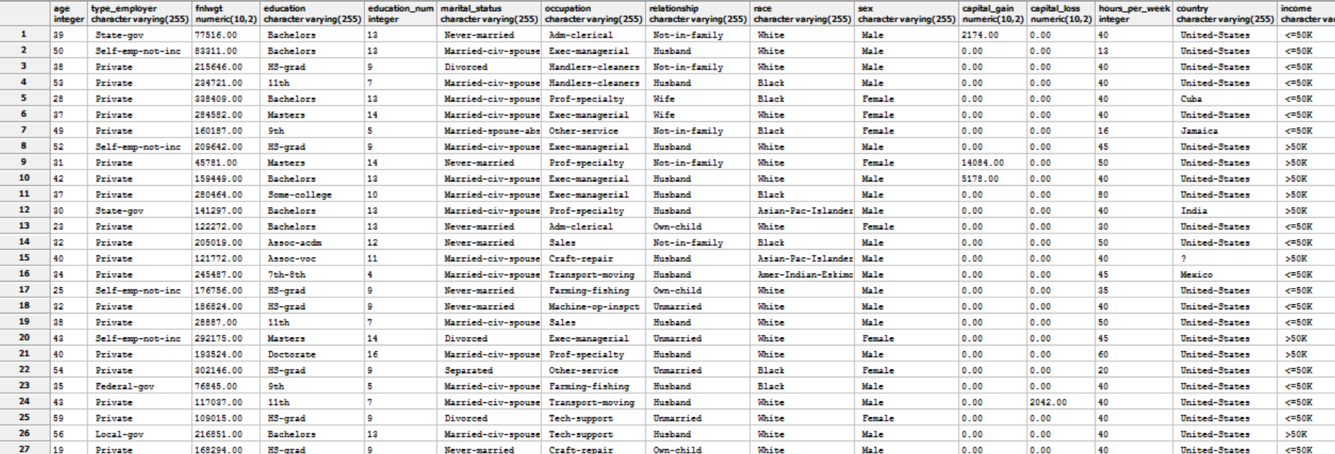
Data Set
Features to predict whether the salary is greater than 50k or not

Slide 22
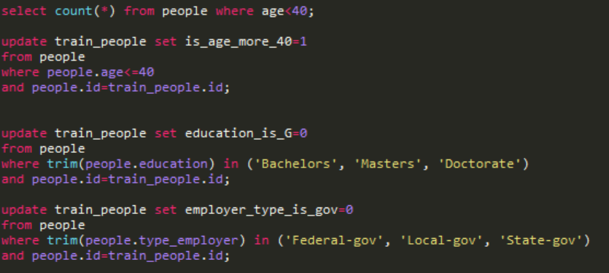
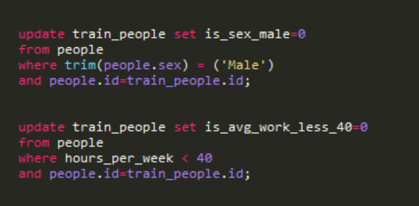
Implementation
Get Ready to inject knowledge into a Machine Learning model

Slide 23
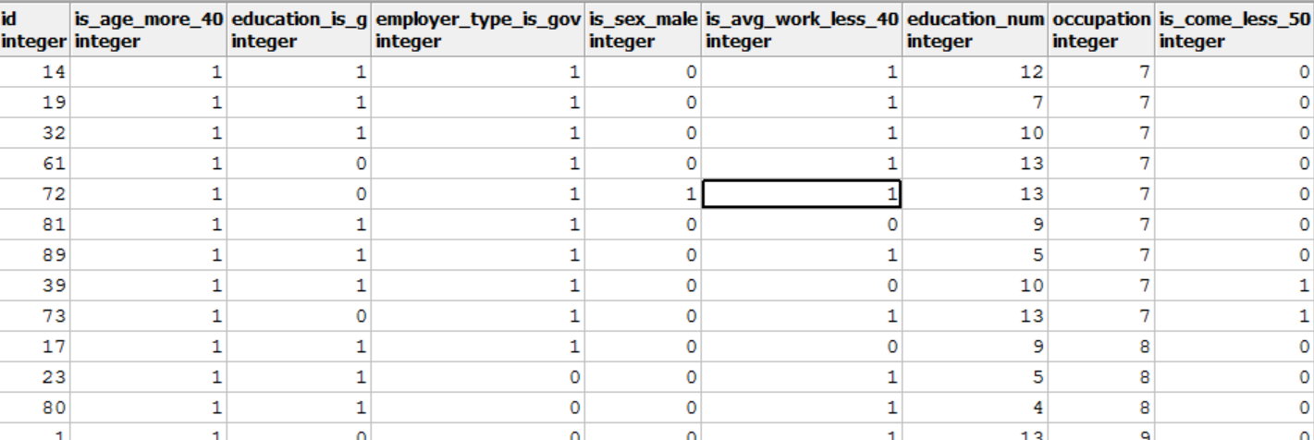
Modified Features

Slide 24
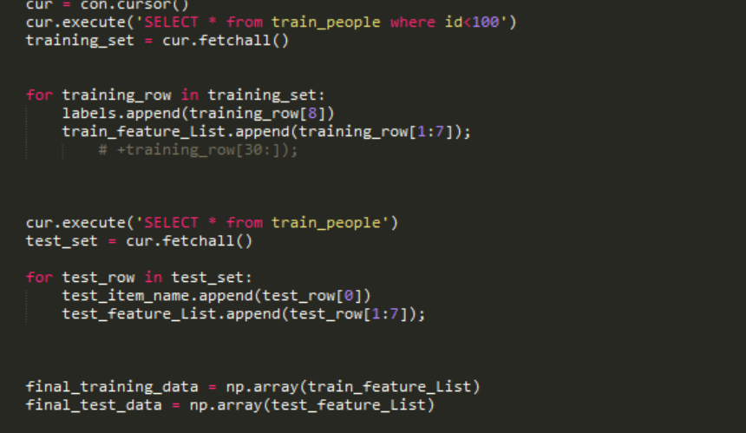
Use Features in sklearn

Slide 25
Exercise:
Which features are important for this dataset?
How have salaries changed over time between different groups of people?
How are base pay, overtime pay, and benefits allocated between different groups?
Data Source:
http://transparentcalifornia.com/salaries/san-francisco/
Employee attributes:
Id, EmployeeName, JobTitle, BasePay, OvertimePay, OtherPay, Benefits, TotalPay, TotalPayBenefits, Year, Notes, Agency, Status

Slide 26
Algorithms
How can we handle the features?
Algorithms
Labeled?
Supervised
Logistic Regression
Support Vector Machine
Unlabeled?
Unsupervised
K-means Clustering
Random Forest
Linear Regression

Slide 27
Supervised Algorithms

Slide 28
Linear Regression
An association between quantitative variables
Predict value of a variable given multiple variables
y = a + bX
Y is linearly dependent on X
h_{θ(x)} = θ₀ + θ₁x₁ + θ₂x₂
θ_{i} ’s are the parameters and h is hypothesis
Evaluation - For test data, compare h_{θ(x)} with the actual value y

Slide 29
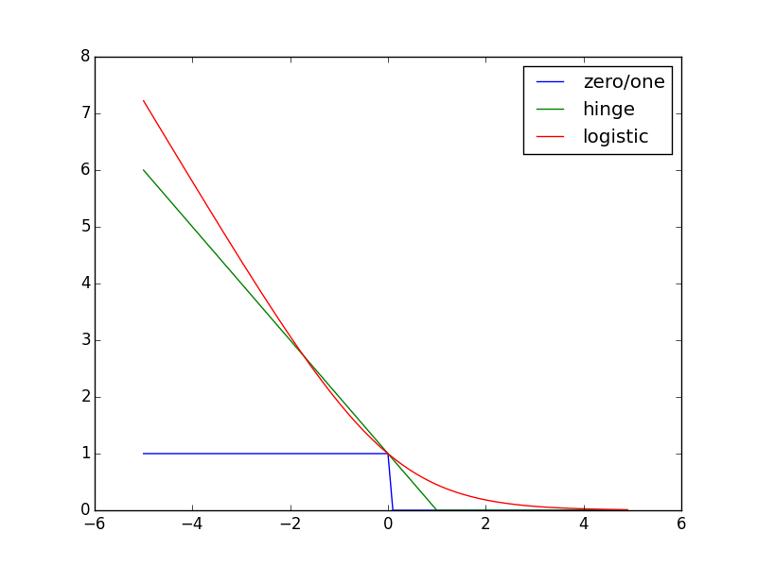
Classification
Training data: pairs.
Minimizing loss functions:
zero/one loss - maximize a posterior estimator
Hinge loss - support vector machine
Logistic loss - logistic regression
More advanced:
Robust Bayesian estimation:
https://arxiv.org/pdf/math/0410076.pdf

Slide 30
Logistic Regression
Fitting a probabilistic discriminative model:
Training objective -- logistic loss
Variants:
nonlinear -- kernel function
Ref: https://en.wikipedia.org/wiki/Logistic_regression

Slide 31
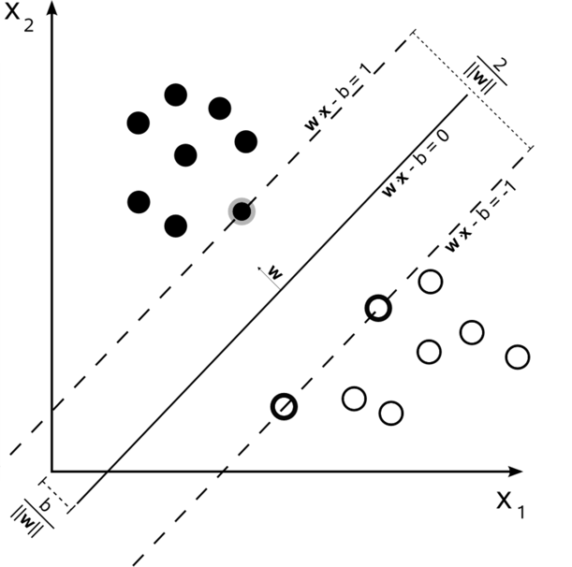
Support Vector Machine
Separate X with a (p-1)-dimensional hyperplane
Linear:
Hard margin:
Positive:
Negative:
Objective
Variants:
Soft margin
Nonlinear via kernel functions
zero hinge loss!
Ref: https://en.wikipedia.org/wiki/Support_vector_machine

Slide 32
Random Forest
A decision tree is a series of decisions that can be used to classify an observation in a dataset.
Random forest creates a bunch of random decision trees automatically.
When a tree uses one variable and another doesn't, we can compare the value lost or gained from the inclusion/exclusion of that variable.
Ref: http://blog.yhat.com/posts/random-forests-in-python.html

Slide 33
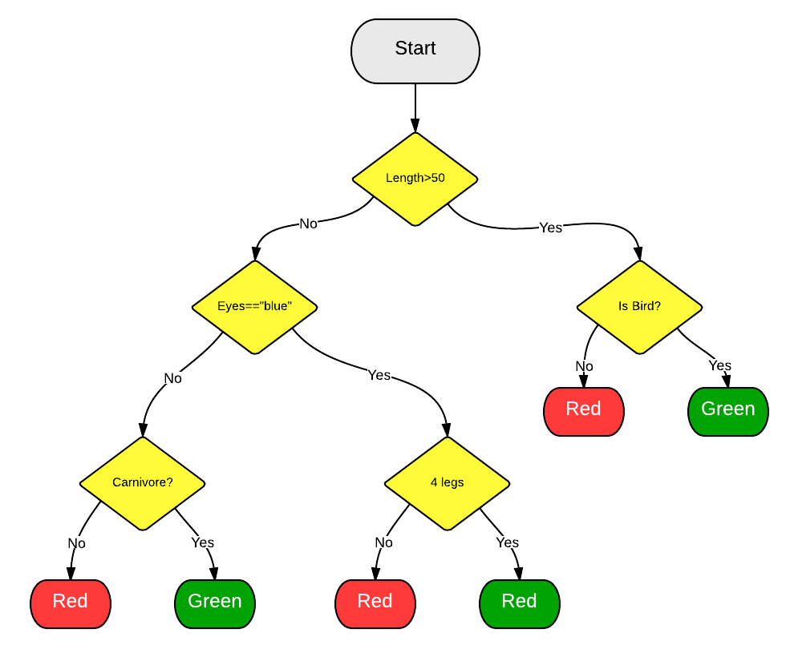
Random Forest
If an observation has a length of 55 and is a bird it's going to be classified as Green.

Slide 34
sklearn implementation
SVM
Logistic regression
Random forest
from sklearn.svm import SVC
clf = SVC()
clf.fit(train, trainLabels)
algoLabels = clf.predict(test)
from sklearn.linear_model import LogisticRegression
lr = LogisticRegression()
lr.fit(train, trainLabels)
algoLabels = lr.predict(test)
from sklearn.ensemble import RandomForestClassifier
rf = RandomForestClassifier()
rf.fit(train, trainLabels)
algoLabels = rf.predict(test)

Slide 35
Linear Regression Implementation
Select features from dataset and create X and y
Feature
Feature_cols= (‘business_svg_stars’, ‘user_avg_stars’, ‘user_review_count’, ‘business_review_count’)
X=df(feature_cols)
Y=df.stars

Slide 36
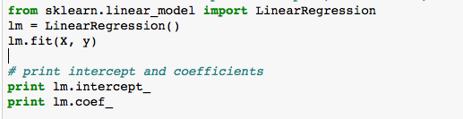

Implementation Details
Use LinearRegression from sklearn linear model
Predict the ratings for test data

Slide 37
Exercise
In the above linear regression implementation, check what is the correlation between features by including latitude and longitude features.
Does including location variables change the accuracy of linear fit?

Slide 38
Unsupervised Learning
Unlabeled data
Try to find patterns in the raw data
Cluster data into groups based on the common patterns – Clustering Algorithms

Slide 39
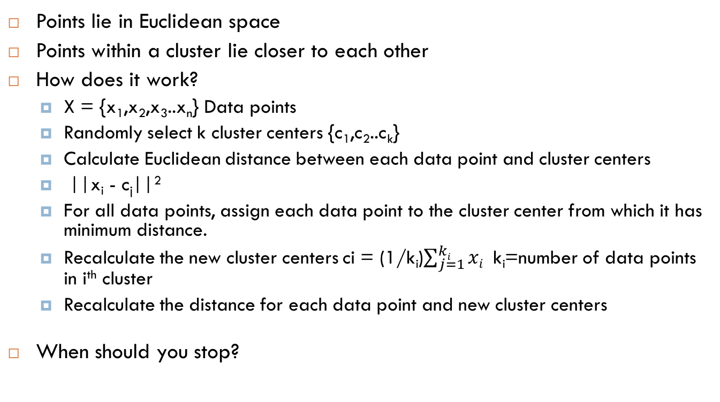
K-Means Clustering
Points lie in Euclidean space
Points within a cluster lie closer to each other
How does it work?
X = {x₁,x₂,x₃..x_{n}} Data points
Randomly select k cluster centers {c₁,c₂..c_{k}}
Calculate Euclidean distance between each data point and cluster centers
||x_{i} - c_{j}||²
For all data points, assign each data point to the cluster center from which it has minimum distance.
Recalculate the new cluster centers ci = (1/k_{i})$\sum_{j=1}^{ki}{xi}$ k_{i}=number of data points in i^{th} cluster
Recalculate the distance for each data point and new cluster centers
When should you stop?

Slide 40
Exercise
Given the following data points cluster them in 3 clusters.
3,10,15,25,22,9,34,18,19

Slide 41
How to choose k?
Number of clusters for the dataset
Correct choice often ambiguous
The Elbow method
Choose a number K such that adding another cluster does not give a better modeling of the data
The total within cluster distance should be minimized to make the clusters compact

Slide 42
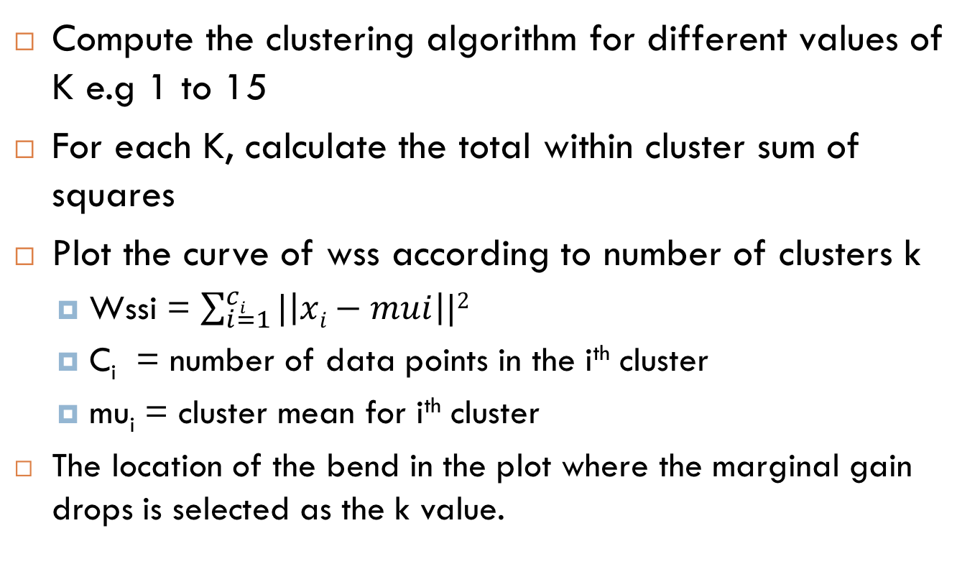
The Elbow Method
Compute the clustering algorithm for different values of K e.g 1 to 15
For each K, calculate the total within cluster sum of squares
Plot the curve of wss according to number of clusters k
Wssi = $\sum_{i=1}^{ci}{|\left|xi−mui\right||2}$
C_{i} = number of data points in the i^{th} cluster
mu_{i} = cluster mean for i^{th} cluster
The location of the bend in the plot where the marginal gain drops is selected as the k value.

Slide 43
Exercise
For the given yelp reviews data set determine K using elbow method.
Features – latitude, longitude and business_avg_stars
Using the k determined above, cluster the businesses in K clusters using k-means clustering

Slide 44
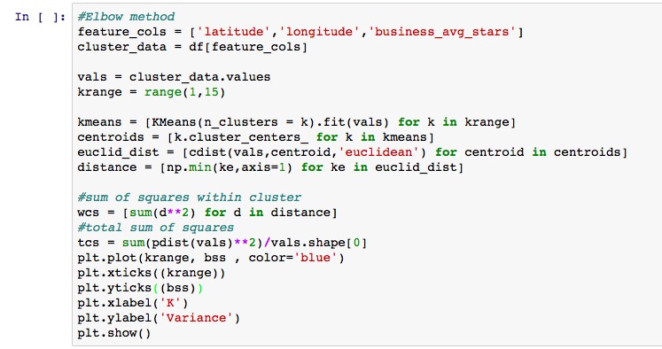
Implementation Details
Elbow method –

Slide 45
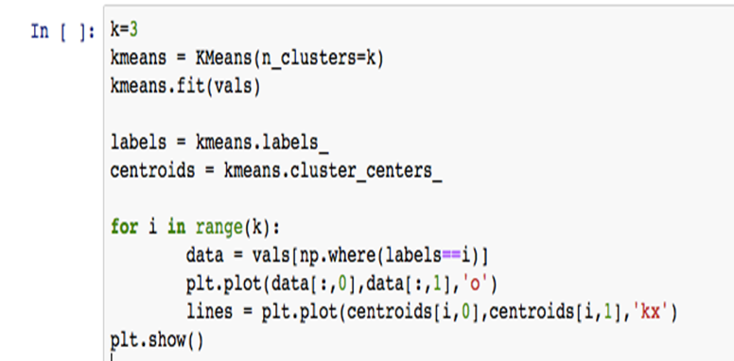
K-Means implementation

Slide 46
Evaluation
How to evaluate the performances?

Slide 47
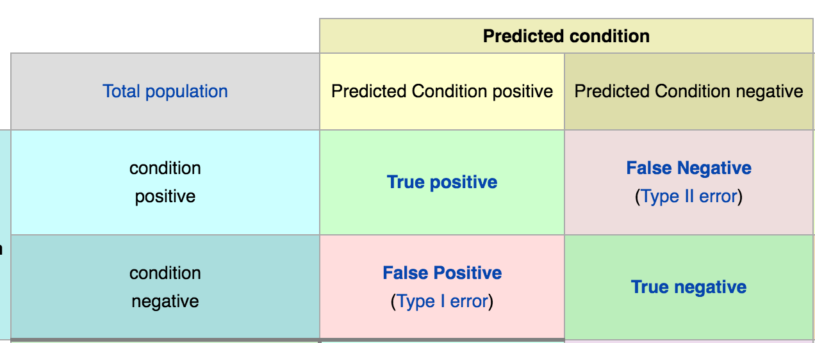
Classification
Loss function
Confusion matrix
Accuracy: TP + FN
Variants:
Precision/recall/f-score
Ref: https://en.wikipedia.org/wiki/Confusion_matrix

Slide 48
Back to our problems

Slide 49
Sentiment Analysis
IMDB movie review (Mass et al. 2011)
http://ai.stanford.edu/~amaas/data/sentiment/
Accuracy (x100) | Logistic regression | Random Forest
Unigram count | 86.67 | 74.28
Unigram tf-idf | 88.32 | 73.37
Bigram count | 89.636 | 74.71
Bigram tf-idf | 88.62 | 73.95

Slide 50
Binary Classification
Employee Data Set
http://archive.ics.uci.edu/ml/datasets/Adult
Accuracy (x100) | SVM | Logistic regression | Random Forest
Unigram count | 79.16 | 77.8 | 81.26

Slide 51
Exercise:
Questions on Algorithms:
Predict whether there is pay discrimination based on gender
Use Sklearn to implement Logistic Regression, SVM and Random Forest
Find the Accuracy, Precision and F1-score for each models

Slide 52
Prediction and Classification
Predict the ratings for a business given user review and average ratings?
Data source – Yelp Reviews (Provided with the lecture material)

Slide 53
Wrap things up
Intro to machine learning
Three steps:
Features
Algorithms
Evaluations

